Slide 1

How the Internet Works
(in 50 mins)
Nick McKeown
Professor of Electrical Engineering
and Computer Science, Stanford University

Slide 2


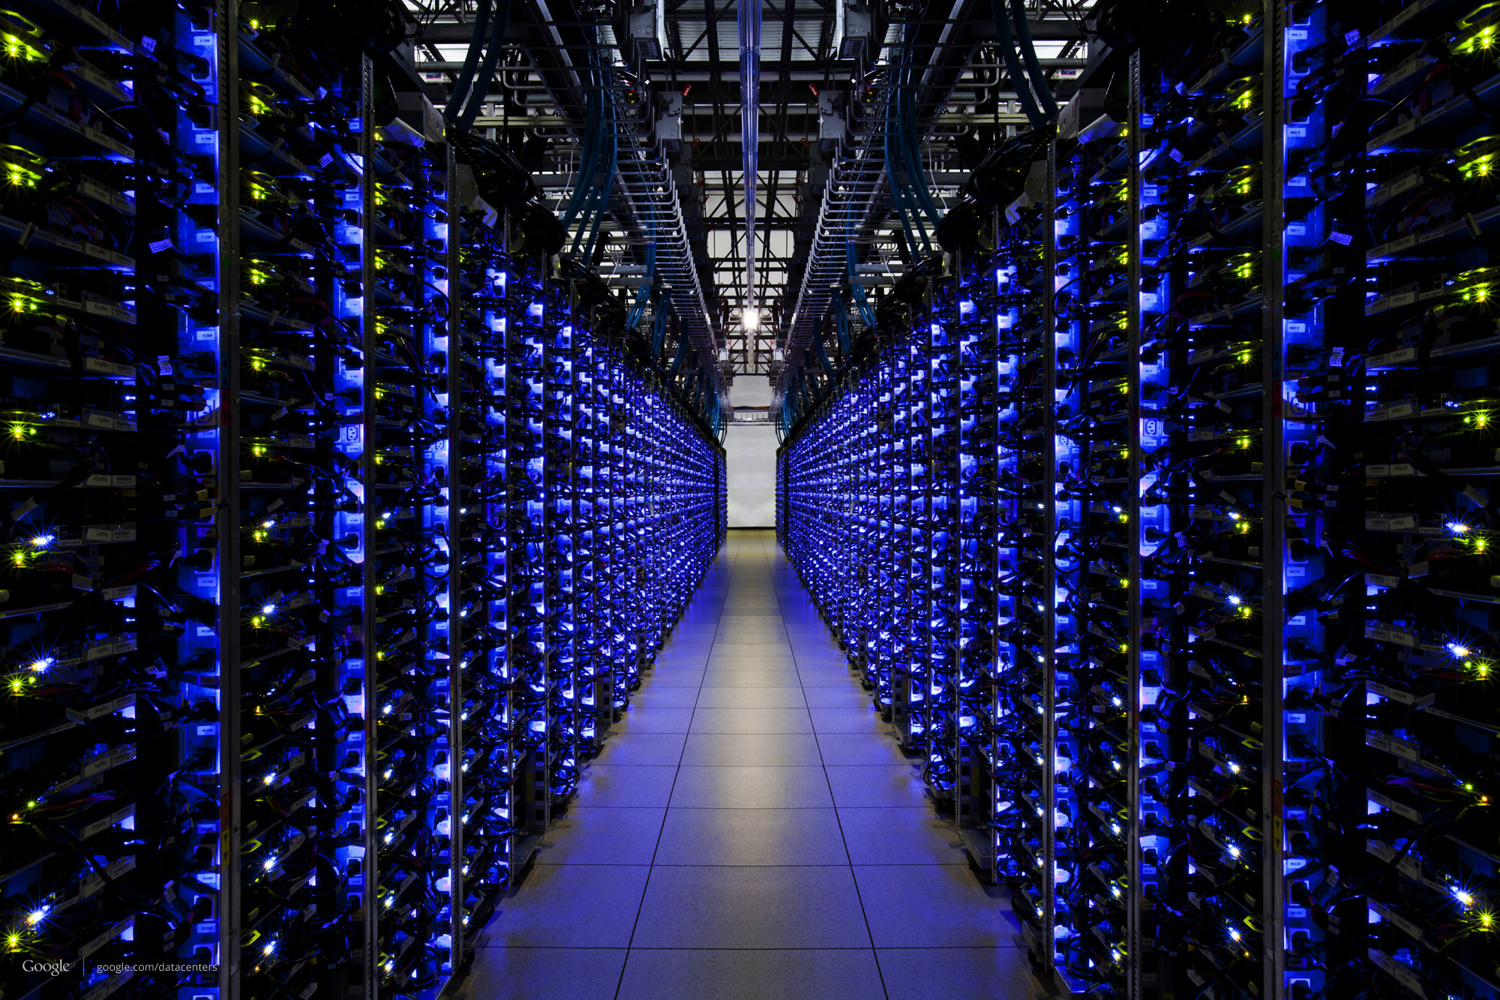
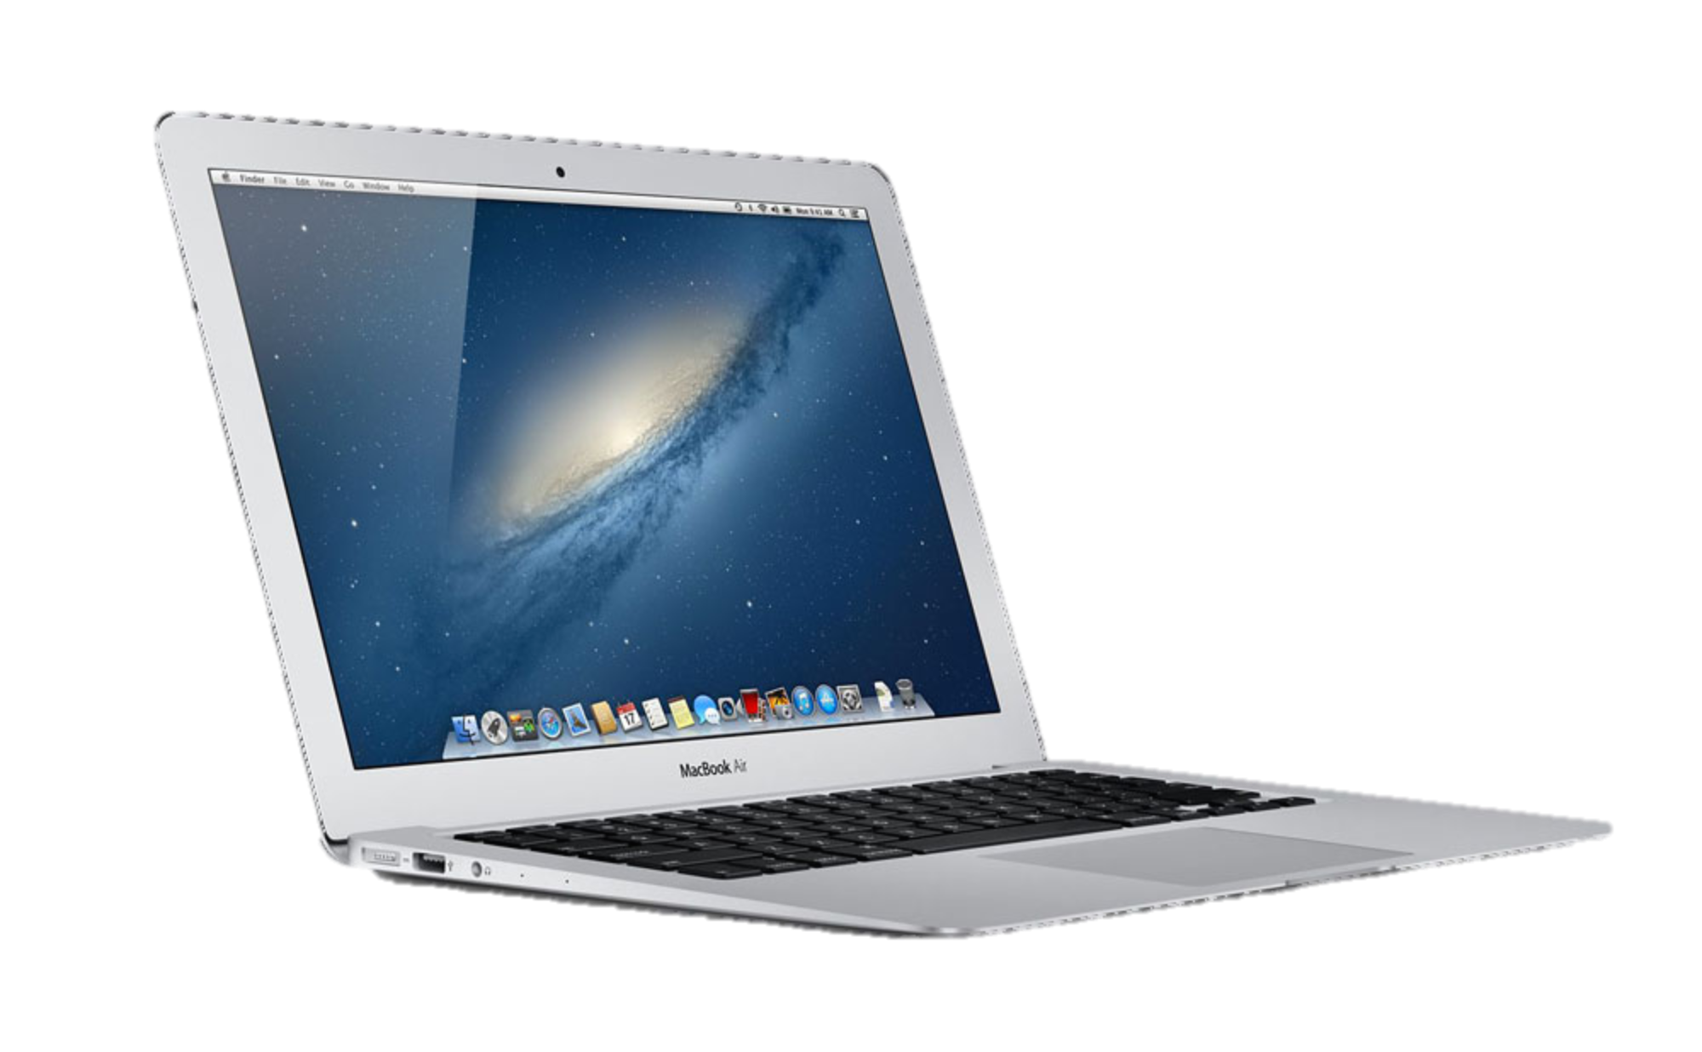
www.stanford.edu

Slide 3

Someone else’s
Program
My
Program

Slide 4
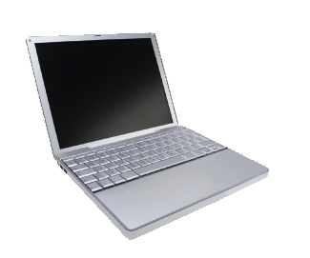
Data
Data

Slide 5
Data

Slide 6
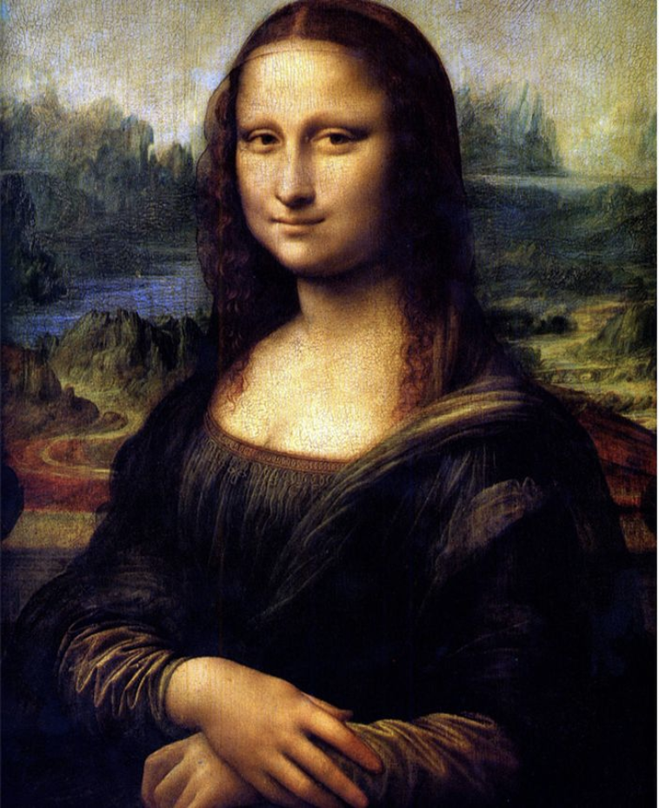
Notes:
Let’s see how this image is sent across the Internet from one smartphone to another….

Slide 7
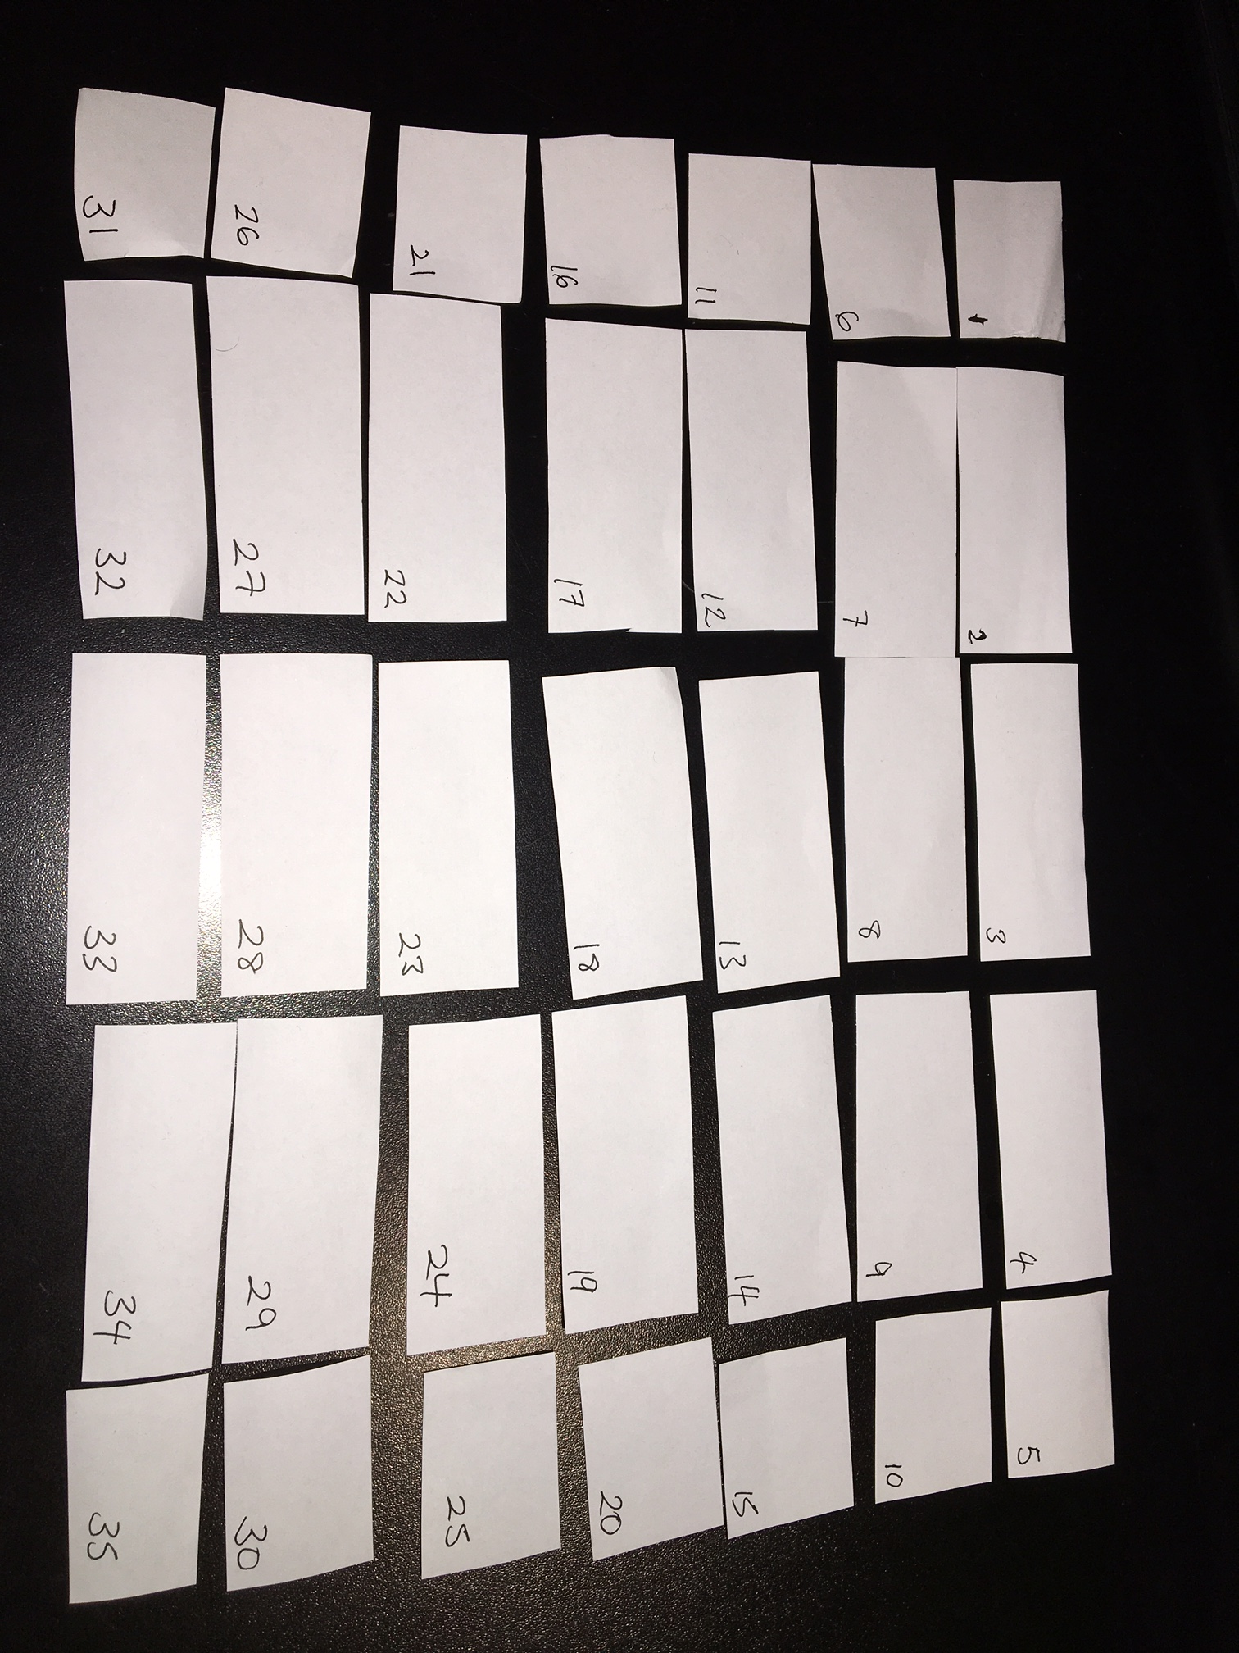

Slide 8

A more accurate model
From
Address
Nick McKeown
Gates 344, Stanford University
Stanford, CA 94305-9030
USA
To
Address
Me
You

Slide 9
Multiple packets in pipeline at same time
Nick McKeown
Gates 344, Stanford University
Stanford, CA 94305-9030
USA
Nick McKeown
Gates 344, Stanford University
Stanford, CA 94305-9030
USA
Nick McKeown
Gates 344, Stanford University
Stanford, CA 94305-9030
USA
Nick McKeown
Gates 344, Stanford University
Stanford, CA 94305-9030
USA
Nick McKeown
Gates 344, Stanford University
Stanford, CA 94305-9030
USA
Me
You

Slide 10
Packets may be damaged
?!%%*
Data
Data

Slide 11
Packets may arrive out of order
1
2

Slide 12
Packets may be duplicated
Duplicate
Data
Data

Slide 13
They may not arrive at all!
Data
Data
Full

Slide 14
Summary so far
Applications send and receive data in packets….
…over an Internet that is unreliable.

Slide 15
How packets find their way across the Internet

Slide 16
Internet addresses
Data
Internet “IP”
Address
Data

Slide 17
Internet Addresses (“IP address”)
Data
Internet “IP”
Address
All Internet packets carry a destination IP address.
We usually write the IP address like this:
171.64.74.58

Slide 18
Routers forward packets one at a time.
Routers look at IP addresses, then send packets to a router closer to the destination.
Data
Data

Slide 19
IP Addresses
The IP address tells a router where to send the packet next.
IP addresses have structure
The computer yuba.stanford.edu
Stanford University
A network in the CS department at Stanford University
171.64.74.58
An address at Koç University
The computer www.ku.edu.tr
An address managed by RIPE (European IP Networks)
88.255.96.208

Slide 20
Can we see the path our packets take?
Yes!
On your computer, try: “ping yuba.stanford.edu”
and “traceroute yuba.stanford.edu”
(Windows: “tracert yuba.stanford.edu”)
Notes:
traceroute –q1 yuba.stanford.edu

Slide 21
ping www.doshisha.ac.jp
From yuba (at Stanford), it takes about 115ms to reach Japan and back again (“round-trip-time”)

Slide 22
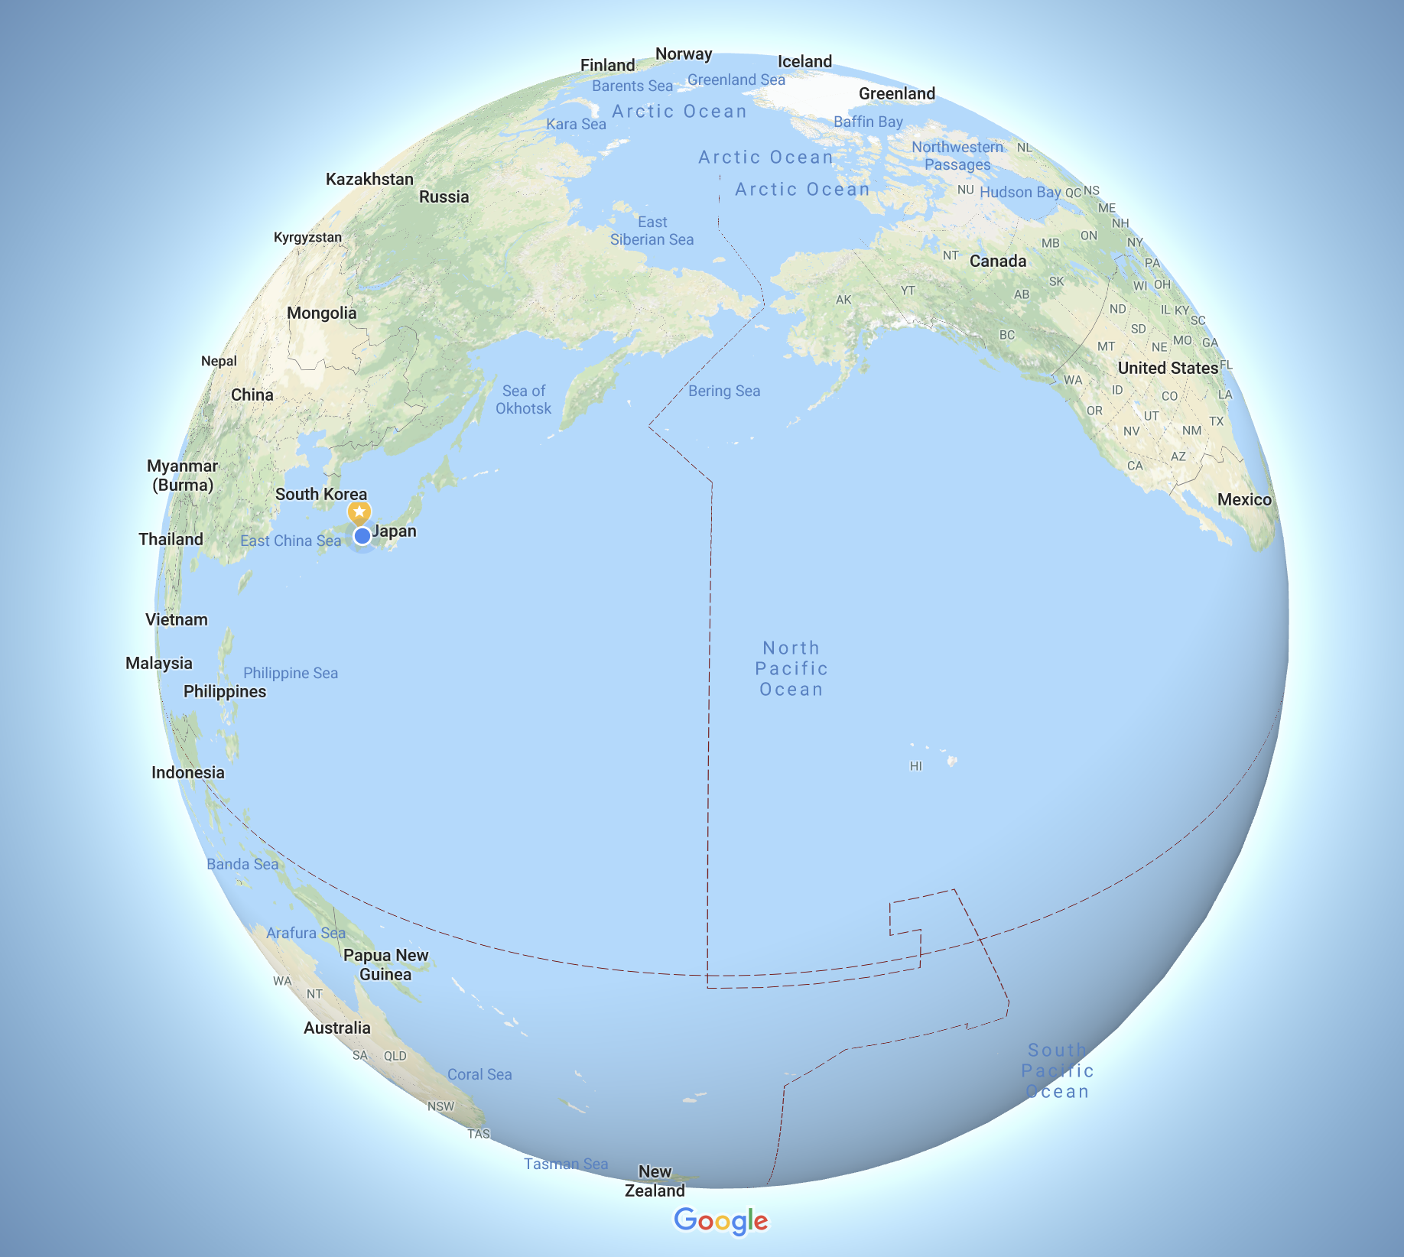
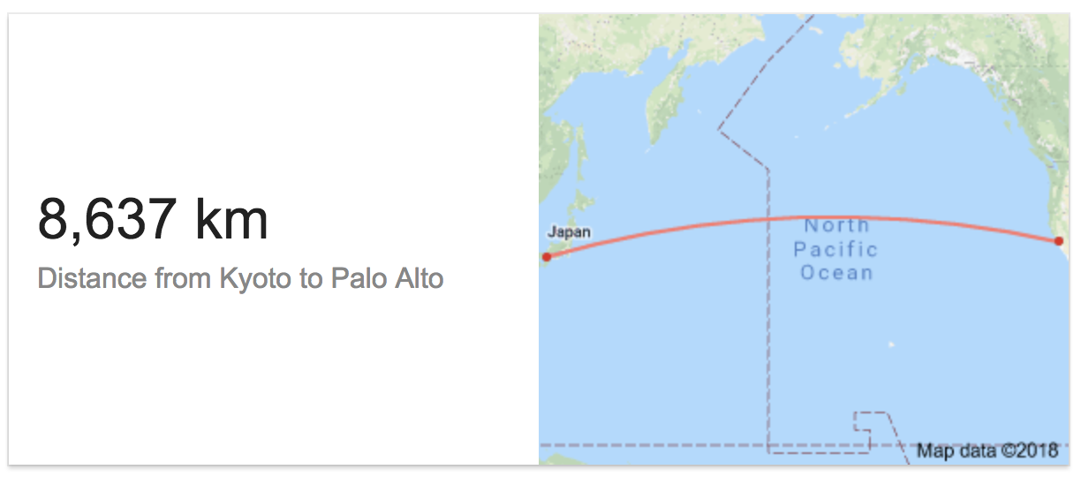
Stanford
Kyoto

Slide 23
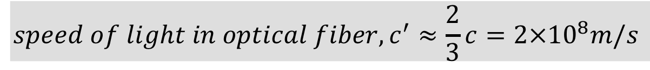
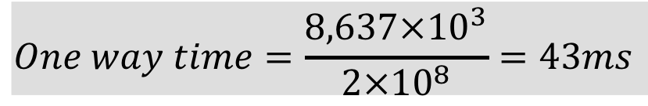
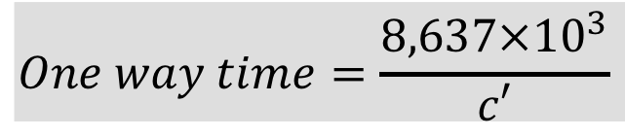
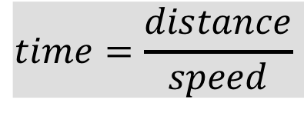
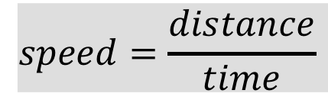

8,637km
RTT = 86ms
$$speed=\frac{distance}{time}$$
Stanford
$$time=\frac{distance}{speed}$$
Kyoto
$$One way time=\frac{8,637×{10}^{3}}{c′}$$
$$speed of light in optical fiber, c^{′}≈\frac{2}{3}c=2×{10}^{8}m/s$$
$$One way time=\frac{8,637×{10}^{3}}{2×{10}^{8}}=43ms$$
$$Round trip time=2×43ms=86ms$$
Q: So why did my “ping” take 115ms?

Slide 24
traceroute

Slide 25
From Stanford to Doshisha University (Kyoto)
nickm@yuba.Stanford.EDU > traceroute –q1 istc.doshisha.ac.jp
traceroute to istc.doshisha.ac.jp (202.23.190.159), 30 hops max, 40 byte packets
1 csmx-west-rtr.SUNet (171.64.74.2) 0.234 ms
2 hpr-svl-rtr-vlan3.SUNet (171.66.255.186) 0.423 ms
3 hpr-svl-hpr2--stan-ge.cenic.net (137.164.27.161) 0.779 ms
4 hpr-lax-hpr3--svl-hpr3-100ge.cenic.net (137.164.25.73) 8.627 ms
5 sinet-1-lo-jmb-702.lsanca.pacificwave.net (207.231.240.135) 8.793 ms
6 tokyo1-GM-ET-8-3-0-100.s5.sinet.ad.jp (150.99.89.242) 108.852 ms
7 kyoto-RM-ET-7-1-0-1151.s5.sinet.ad.jp (150.99.89.184) 114.829 ms
8 doshisha-LAN.gw.sinet.ad.jp (150.99.196.66) 115.249 ms
9 ***

Slide 26
Stanford
Kyoto
Stanford-LAX: 500km
LAX-Tokyo: 8,800km
Tokyo-Kyoto: 500km
RTT ~= 100ms

Slide 27
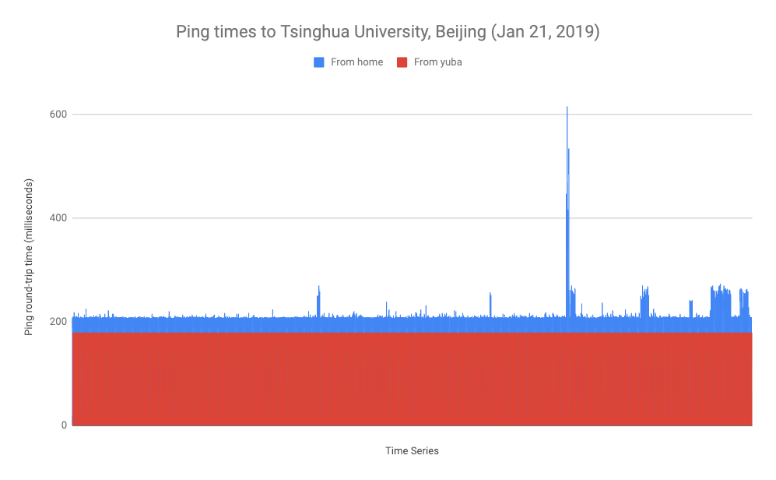

Slide 28
Try traceroute to….
yuba.stanford.edu, www.google.com, www.ntua.gr, …

Slide 29
nickm @ home on Comcast network $ traceroute -q1 www.ntua.gr
traceroute to www.ntua.gr (147.102.224.101), 64 hops max, 52 byte packets
1 testwifi.here (192.168.86.1) 0.921 ms
2 96.120.91.229 (96.120.91.229) 8.491 ms
3 be-20052-rur02.santaclara.ca.sfba.comcast.net (68.87.196.49) 10.237 ms
4 162.151.78.129 (162.151.78.129) 8.857 ms
5 be-232-rar01.santaclara.ca.sfba.comcast.net (162.151.78.253) 8.941 ms
6 be-3651-cr02.sunnyvale.ca.ibone.comcast.net (68.86.91.73) 9.485 ms
7 be-11083-pe02.529bryant.ca.ibone.comcast.net (68.86.84.14) 10.357 ms
8 50.248.118.238 (50.248.118.238) 9.467 ms
9 be2016.ccr22.sfo01.atlas.cogentco.com (154.54.0.177) 11.134 ms
10 be3110.ccr32.slc01.atlas.cogentco.com (154.54.44.142) 35.123 ms
11 be3038.ccr22.den01.atlas.cogentco.com (154.54.42.98) 35.458 ms
12 be3036.ccr22.mci01.atlas.cogentco.com (154.54.31.90) 53.296 ms
13 be2832.ccr42.ord01.atlas.cogentco.com (154.54.44.170) 58.615 ms
14 be2718.ccr22.cle04.atlas.cogentco.com (154.54.7.130) 65.101 ms
15 be2994.ccr32.yyz02.atlas.cogentco.com (154.54.31.234) 73.458 ms
16 be3260.ccr22.ymq01.atlas.cogentco.com (154.54.42.90) 85.407 ms
17 be3043.ccr22.lpl01.atlas.cogentco.com (154.54.44.165) 150.394 ms
18 be2183.ccr42.ams03.atlas.cogentco.com (154.54.58.70) 156.881 ms
19 be2814.ccr42.fra03.atlas.cogentco.com (130.117.0.142) 162.831 ms
20 be2960.ccr22.muc03.atlas.cogentco.com (154.54.36.254) 169.709 ms
21 be3462.ccr52.vie01.atlas.cogentco.com (154.54.59.181) 173.362 ms
22 149.6.175.250 (149.6.175.250) 173.362 ms
23 ae1.mx1.ath2.gr.geant.net (62.40.98.146) 200.320 ms
24 grnet-ias-grnet-gw.mx1.ath2.gr.geant.net (83.97.88.66) 206.457 ms
25 eier-kolettir-ae.backbone.grnet.gr (62.217.100.63) 208.703 ms
26 ntua-zogr-3.eier.access-link.grnet.gr (62.217.96.169) 201.891 ms
27 *
nickm@yuba.Stanford.EDU > traceroute -q1 www.ntua.gr
traceroute to www.ntua.gr (147.102.224.101), 30 hops max, 40 byte packets
1 csee-west-rtr-vl3874.SUNet (171.64.74.2) 0.289 ms
2 hpr-svl-rtr-vlan2.SUNet (171.64.255.147) 0.637 ms
3 hpr-svl-hpr3--stan-100ge.cenic.net (137.164.27.60) 0.657 ms
4 hpr-lax-hpr3--svl-hpr3-100ge.cenic.net (137.164.25.73) 8.558 ms
5 hpr-i2--lax-hpr3-r-and-e.cenic.net (137.164.26.201) 8.723 ms
6 ae-5.4079.rtsw.wash.net.internet2.edu (162.252.70.158) 68.694 ms
7 internet2-gw.mx1.lon.uk.geant.net (62.40.124.44) 143.377 ms
8 ae6.mx1.lon2.uk.geant.net (62.40.98.37) 144.475 ms
9 ae5.mx1.par.fr.geant.net (62.40.98.179) 151.959 ms
10 ae5.mx1.gen.ch.geant.net (62.40.98.182) 158.004 ms
11 ae4.mx1.mil2.it.geant.net (62.40.98.89) 164.868 ms
12 ae3.mx2.ath.gr.geant.net (62.40.98.151) 187.210 ms
13 grnet-gw.mx2.ath.gr.geant.net (62.40.124.90) 186.227 ms
14 ntua-zogr-3.eier.access-link.grnet.gr (62.217.96.169) 188.246 ms
15 *

Slide 30
Competition (optional)
Task: Find the longest loop-free traceroute in the Internet
Rules
We must see it! So it must either be reproducible by the teaching staff, or you can send us a video screencast.
The source and destination can be any addresses you can reach.
At most one hop may return a “*” (i.e. not respond)
Packets must flow over physical links and through real routers. i.e. not a virtual, simulated or emulated network.
You must turn in your solution by Friday Sept 18th at 7pm Stanford time.
Prize: A small prize and big bragging rights!

Slide 31
Summary so far
Applications send and receive data in packets….
…over an Internet that is unreliable.
Packets are forwarded hop-by-hop based on the final destination address.

Slide 32
The Internet cannot be trusted!!
The Internet doesn’t promise to deliver packets in order.
It doesn’t promise to deliver packets quickly, or on time.
It doesn’t even promise to deliver them at all!
It just makes a “best-effort” attempt.
Data

Slide 33
Sending data reliably over an Internet that is unreliable

Slide 34
How Network Applications Communicate
Someone else’s
Program
My
Program
The most common method:
Communication is in both directions – “bidirectional”.
Communication is reliable (if there is a working path between the two computers).
It’s like an unformatted pipe:
You push data in at one end, and it pops out correctly at the other end.
The applications decide how the data is formatted inside the pipe.

Slide 35

Byte Stream Model
Setup connection
Internet
A
B

Slide 36
Byte Stream Model
Stream of bytes
Stream of bytes
Internet
A
B

Slide 37
Byte Stream Model
Close connection
Internet
A
B

Slide 38
World Wide Web (HTTP)
Client
Server
Setup connection
Internet
www.stanford.edu

Slide 39
World Wide Web (HTTP)
Client
Server
Stream of bytes
GET/HTTP/1.1 index.html
Internet
Stream of bytes
HTTP/1.1 200 OK <…contents of index.html…>
www.stanford.edu

Slide 40
World Wide Web (HTTP)
Client
Server
Close connection
Internet
www.stanford.edu

Slide 41
Your Application program
e.g. Chrome, Skype
The server
e.g. Google, Facebook
TCP makes sure all
the data is delivered
“TCP”
“TCP”
“IP”
“IP”
Data

Slide 42
TCP’s job
Makes sure all data is delivered correctly.
Delivers data to the application in the right order.
How?
Add sequence numbers to every packet (so the receiver can check if any are missing, and put them in right order)
When a packet arrives, send an acknowledgment of receipt or “ACK” back to the sender
If no acknowledgment is received, resend the data

Slide 44
Packets are “encapsulated” by different “layers” of processing

Slide 45
http client (e.g. Chrome)
Chrome
http request
Application
GET index.html
TCP
TCP
TCP
(http)
“Deliver to the http server”
(http)
IP
IP
TCP
IP address
(TCP)
IP
IP address
(TCP)
“…at this destination”
(http)
Ethernet
Ethernet
IP
Ethernet
Ethernet “MAC” address
(IP)
“…starting with this link”
TCP
Ethernet “MAC” address
(IP)
IP address
(TCP)
(http)

Slide 46
Here it goes….
Ethernet data
IP data
TCP data
IP Address
(TCP)
Ethernet “MAC” address
(IP)
(http)

Slide 47
http server (e.g. www.google.com)
http server
http request
Application
GET file
“Deliver to the http server”
TCP
TCP
(http)
“Deliver to TCP”
IP
Ethernet
IP
IP
Ethernet
TCP
TCP
Ethernet “MAC” address
(IP)
IP address (TCP)
IP address
(TCP)
(http)
(http)

Slide 48
Summary of what we learned
My
Program
Someone else’s
Program
Applications send and receive data in packets….
…over an Internet that is unreliable.
Packets are forwarded hop-by-hop using the IP destination address.
Our applications use TCP to make sure they are
delivered and put back in the correct order.

